Slide 1
Activity Diagrams

Slide 2
Nama kelompok:
Muhammad Alfian (201851040)
Azka Amal (201851042)
Andika Eka Saputra (201851044)
Laila Kumala Sari (201851046)
Muhammad Rifqi Ramadhan (201851047)
Muhammad Minwaal Dani (201851049)
Moh Lukman Hakim (201851050)
Agustina Wahyu Rahma P (201851052)
Windu Aji Pramudya (201851072)
Dimas Satrio Oktavianto (201851084)

Slide 3
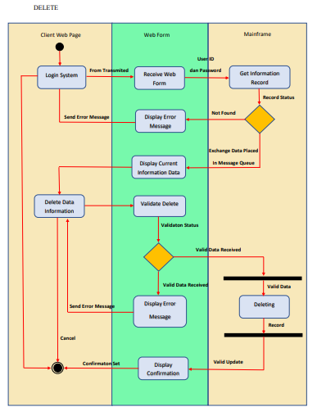

Slide 4
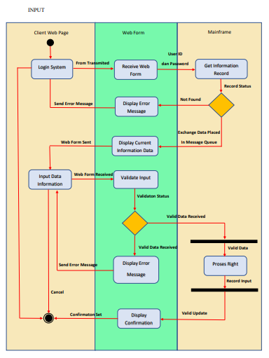

Slide 5
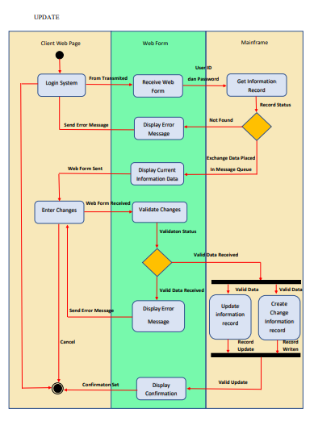

Slide 6
Thank you

